Slide 1
Chapter 3
Types, Objects, and Namespaces

Slide 2
Classes
Classes are the code definitions for objects.
Often called a “blueprint”
Can be used to create multiple instances.
These instances are called objects.

Slide 3
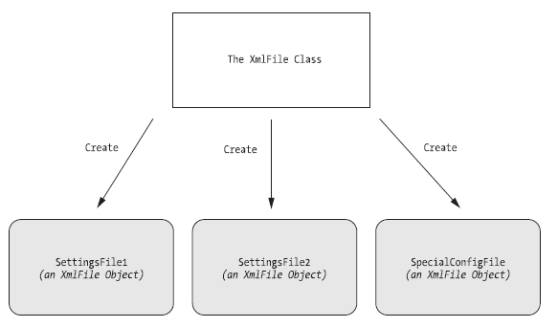
Mulitple instances of a class file

Slide 4
Classes have 3 key ingredients
Properties
Properties allow you to access an object’s data.
Some properties may be read-only, so they cannot be modified.
Methods
Methods allow you to perform an action on an object.
Events
Events provide notification that something has happened.

Slide 5
Static Members
Allow you to use code without creating the object first.
// Get the current date using a static property.
// Note that you need to use the class name DateTime.
DateTime myDate = DateTime.Now;
// Use an instance method to add a day.
// Note that you need to use the object name myDate.
myDate = myDate.AddDays(1);

Slide 6
A Simple Class
To create a class, you must define it using a special block structure:
public class Product
{
private string name;
private decimal price;
private string imageUrl;
}
This class has member variables, which can be used for the whole class file.

Slide 7
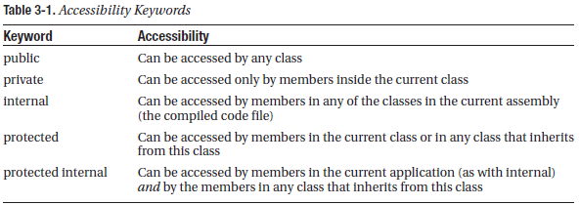
Accessibility

Slide 8
Adding a Method
All the GetHtml() method does is read the private data and format it in some attractive way.
public string GetHtml()
{
string htmlString;
htmlString = "<h1>" + name + "</h1><br />";
htmlString += "<h3>Costs: " + price.ToString() + "</h3><br />";
htmlString += "<img src='" + imageUrl + "' />";
return htmlString;
}

Slide 9
Adding a Constructor
This is a way to create an object with arguments that set the member variables in one step.
public Product(string name, decimal price)
{
// Set the two properties in the class.
Name = name;
Price = price;
}
To Use this…
Product saleProduct = new Product("Kitchen Garbage", 49.99M);

Slide 10
Adding an event
// Define the delegate that represents the event.
public delegate void PriceChangedEventHandler();
public class Product
{
// (Additional class code omitted for clarity.)
// Define the event using the delegate.
public event PriceChangedEventHandler PriceChanged;

Slide 11
public decimal Price
{
get
{ return price; }
set
{
price = value;
// Fire the event, provided there is at least one listener.
if (PriceChanged != null)
{
PriceChanged();
}
}
}
}

Slide 12
Testing the Product Class
Product.cs: This file contains the code for the Product class. It’s in the App_Code subdirectory, which allows ASP.NET to compile it automatically.
Garbage.jpg: This is the image that the Product class will use.
Default.aspx: This file contains the web page code that uses the Product class.

Slide 13
Create a new Project
<%@ Page Language="C#" %>
<script runat="server">
private void Page_Load(object sender, EventArgs e)
{
Product saleProduct = new Product("Kitchen Garbage", 49.99M);
saleProduct.ImageUrl = "garbage.jpg";
Response.Write(saleProduct.GetHtml());
}
</script>
<html>
<head>
<title>Product Test</title>
</head>
<body></body>
</html>

Slide 14
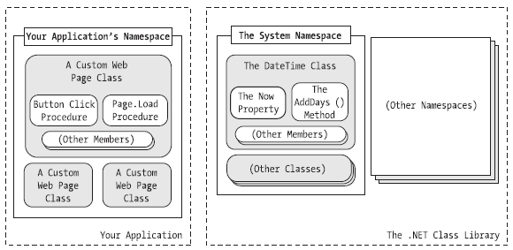
Understanding Namespaces and Assemblies
Namespaces can organize all the different types in the class library. Without namespaces, these types would all be grouped into a single long and messy list.

Slide 15
Advanced Class Programming
These topics are covered at the end of Chapter 3. We will not cover them in this course.
Inheritance
Static Members
Casting Objects
Partial Classes
Generics

